Slide 1
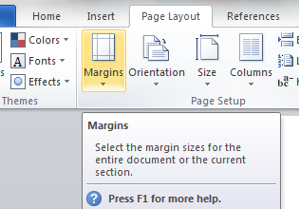
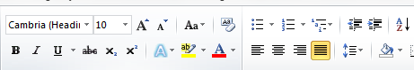

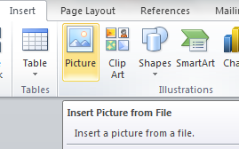
Chapter 17: Document Production (Word)
Task 2- Email Ransom Virus
Page Layout Set the following Margins/Page Size – Right & Left – 1 CM Set the page size to A4 Change the page Orientation from Landscape to Portrait. Header – Date - (Left) Name – (Right)
Text Formatting Create the text styles shown above. Apply the Title style to the main title (Tens of millions …..) Insert your name below the title and apply the subtitle style. Apply the Body Text style to the remaining text. Format the text below your name into two columns.
House Style Specification Sheet Title: Sans Serif, Blue, Bold, 20 pts, centre aligned Subtitle: Serif, Red, single line spacing, 14 pts and Right aligned. Body Text: Serif, Black, single line spacing, 12 pts and Justified. Single line space after each paragraph.

Slide 2
Chapter 17: Document Production (Word)
Task 2- Email Ransom Virus
Enter and edit data from different sources Insert an Computer-Viruses image at the top of the second column on the 1st page. Resize the image so it is aligned to the right of the margin and the height is 3CM (maintain aspect ratio). Format the picture so it is wrapped tight around the text. Insert the a the table from the xls file onto the second page. Ensure the first row is shaded (Grey) and its fits the within the column. Create a Bar Chart and place it at the end of document after the table. Resize the chart to fill the column width if necessary. Spell check and proofread the document. Ensure you have checked for the following: Tables do not overlap two columns or pages There are no widows or orphans There are no blank pages.

